Slide 1
THE DIAGNOSTIC PRECISION OF ARTIFICIAL INTELLIGENCE COMPARED TO RADIOLOGISTS IN INTERPRETING VARIOUS PATHOLOGIES ON CHEST RADIOGRAPH A SYSTEMATIC REVIEW AND PROPORTION META-ANALYSIS
BY
OTIJI ONYINYECHI JENNIFER 2020/249477
OZIOKO NNAEMEKA JOHNPAUL 2019/248590
OZOR ETHELBART OBIOMA 2020/248158
OZOR PRECIOUS IFEGADI 2020/248145
PATRICK VICTORY OLUEBUBE 2020/244832
PROMISE-IHEONUNEKWU UCHECHUKWU 2020/243778
ROWLAND MIRACLE CHIDERA 2020/245755
SAMUEL MARTINS KENECHUKWU 2020/244845
SANUSI ORIPANYE MOSHOOD 2020/248150
SHAIBU STEPHANIE UFEDO 2020/244827
A PROJECT PRESENTED IN PARTIAL FULFILMENT OF THE REQUIREMENTS FOR THE AWARD OF BACHELOR OF SCIENCE (B.Sc.) DEGREE IN MEDICAL RADIOGRAPHY AND RADIOLOGICAL SCIENCES
DEPARTMENT OF MEDICAL RADIOGRAPHY AND RADIOLOGICAL SCIENCES
FACULTY OF HEALTH SCIENCES AND TECHNOLOGY
UNIVERSITY OF NIGERIA, ENUGU CAMPUS, COLLEGE OF MEDICINE
SUPERVISOR:
DR SOBECHUKWU W.I ONWUZU
NOVEMBER, 2025

Slide 2
OUTLINE
Title Page
Introduction
Statement of the Problem
Objectives / Significance of the Study
Review of Related Literature
Research Methodology
Flow Chart of Database Search
Results
Discussion
Summary of Findings / Conclusion
Areas of Further Research / Limitations
References

Slide 3
INTRODUCTION
Chest radiography is one of the most widely used diagnostic tools in medicine.
Essential for detecting thoracic diseases such as pneumonia, pleural effusion, pneumothorax, and lung cancer.
Interpretation accuracy varies due to radiologist workload, image quality, and clinical variables.
Rapid advancements in artificial intelligence (AI), especially deep learning, have introduced new diagnostic possibilities.
Questions remain regarding whether AI can match or exceed radiologists’ diagnostic performance.
This research investigates comparative diagnostic precision between AI models and radiologists.

Slide 4
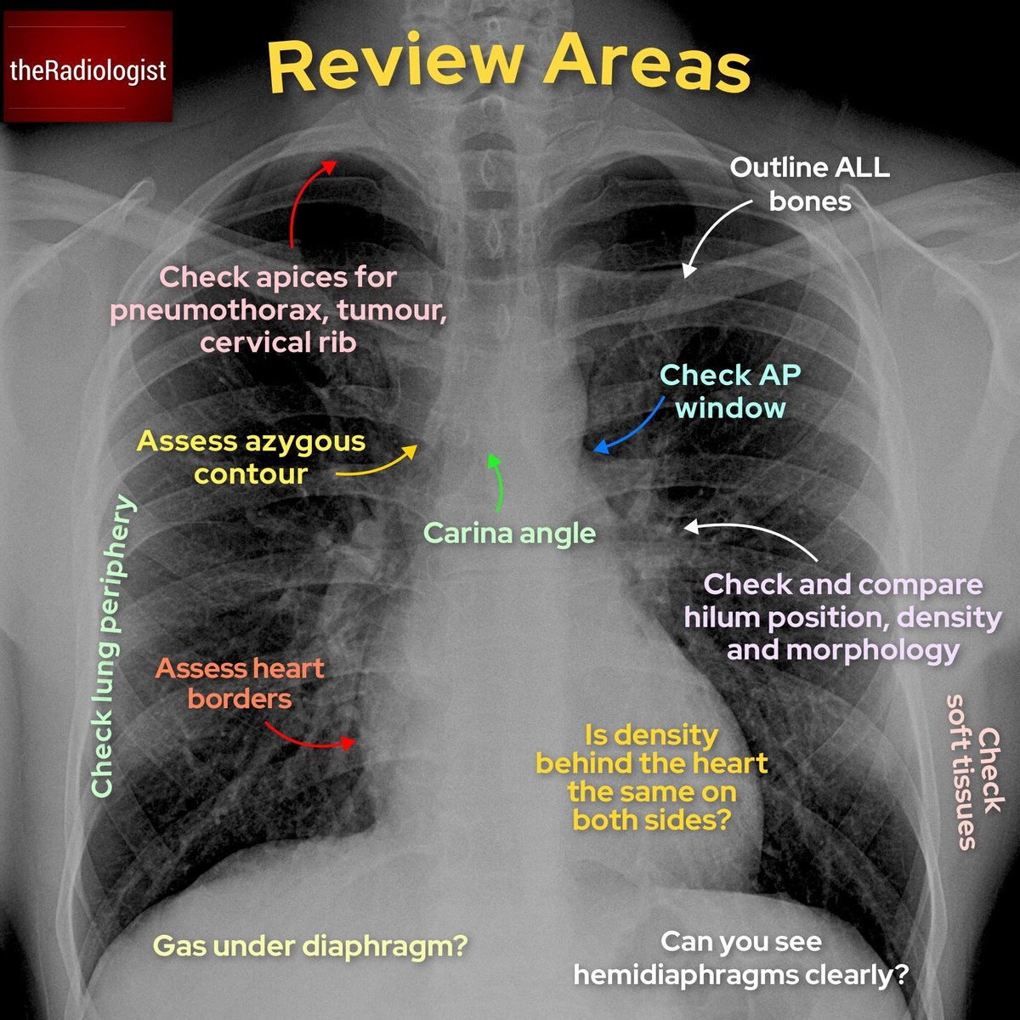
Statement of the Problem
Despite the growing use of AI in chest imaging, uncertainties persist about its diagnostic performance relative to radiologists.
Studies show mixed results—some report AI outperforming radiologists, others highlight inconsistent outcomes.
Lack of a consolidated systematic review limits informed decision-making on clinical integration of AI.
Need for evidence-based comparison to understand where AI excels and where it falls short.

Slide 5
Objectives / Significance of the Study
General Objective: To compare the diagnostic precision of AI and radiologists in interpreting chest radiograph pathologies through systematic review and proportion meta-analysis.
Specific Objectives:
Compare pooled diagnostic accuracy metrics (sensitivity, specificity, AUC) of AI vs radiologists.
Determine diagnostic accuracy of AI across specific thoracic abnormalities (e.g., TB, pneumonia, cardiomegaly).
Examine factors influencing AI performance (dataset size, model type, reference standard).
Significance of the study
Provides evidence for integrating AI into radiology workflows, especially in resource-limited regions.
Informs future AI development, regulatory frameworks, and ethical adoption strategies.

Slide 6
Review of Related Literature
Moore (2022) emphasized the importance of chest radiography as one of the most common diagnostic tools, especially for identifying thoracic abnormalities such as pneumonia, pleural effusion, and heart enlargement.
Parkhomenko et al. (2021) discussed essential radiographic indicators, including rib positioning, lung markings, fissure lines, and mediastinal angles, which influence accurate CXR interpretation.
Arya & Kumar (2023) highlighted the increasing workload on radiologists and the potential for diagnostic errors due to the ever-expanding volume of medical imaging.

Slide 7
Research Methodology
Research Design: Systematic review and proportion meta-analysis.
Inclusion Criteria:
Studies comparing AI algorithms with radiologists using chest radiographs.
Studies reporting diagnostic accuracy metrics.
Publications from 2013–2025.
Exclusion Criteria:
Non-comparative studies, non-CXR modalities, non-English publications.
Databases Searched: PubMed, Scopus, Web of Science, IEEE Xplore, Google Scholar.
Search Strategy: Keywords combining “CXR”, “AI”, “radiologist”, “diagnostic accuracy”, etc.
Data Extraction: Study design, sample size, model type, radiologist comparator, diagnostic metrics.
Quality Assessment: QUADAS-2 tool for bias and validity evaluation.

Slide 8
Flow Chart of Database Search
Articles identified after applying the key phrases using Boolean operators in all the included databases
(n=100)
Identification
Articles discarded as duplicates
(n = 88)
Articles screened by title for relevance
(n = 12)
Screening
Irrelevant titles excluded
(n = 01)
Articles screened by abstract for relevance
(n = 11)
Articles excluded for irrelevance to study aim
(n = 01)
Eligibility
Full-text articles assessed for eligibility criteria
(n = 10)
Articles excluded for not meeting eligibility
(n = 05)
Articles retrieved from manual reference searching
(n = 02)
Included
Full text articles included for study
(n = 07)

Slide 9
RESULTS 1
Table 4.2: Comparison of the diagnostic accuracy of artificial intelligence models and radiologists
S/N | Study (Author, Year) | AUC (AI) | AUC (Human) | Sensitivity (AI) | Sensitivity (Human) | Specificity (AI) | Specificity (Human) | PPV (AI) | PPV (Human) | NPV (AI) | NPV (Human)
1 | Rajpurkar et al., 2018 | 0.807 | N/A | 0.47(0.40-0.54) | 0.84(0.78-0.89) | 0.94(0.91-0.97) | 0.72(0.65-0.77) | 0.68(0.63-0.73) | 0.84(0.79-0.89) | 0.88(0.80-0.93) | 0.71(0.65-0.77)
2 | Ajmera et al., 2022 | N/A | N/A | 0.80 (0.75–0.85). | 0.404(0.345-0.467) | 0.997 (0.990-0.999) | 0.999 (0.993–0.9998) | 0.990 (0.964–0.997) | 0.990 (0.946–0.998) | 0.940 (0.921–0.954) | 0.840 (0.815–0.862)
3 | Maduskar et al., 2013 | 0.91(0.86-0.95 | 0.94(0.89–0.97) | 0.908 (0.843–0.948) | 0.950 (0.895–0.977) | 0.683 (0.530–0.804) | 0.829 (0.687–0.915) | 0.893 (0.826–0.937) | 0.942 (0.885–0.972) | 0.718 (0.562–0.835) | 0.850 (0.709–0.929)
4 | Wu et al., 2020 | 0.865 | N/A | 0.714 (0.635–0.783) | 0.721 (0.642–0.783) | 0.980 (0.973–0.986) | 0.973 (0.971–0.974) | 0.730 (0.650–0.797) | 0.682 (0.670–0.694) | 0.979 (0.971–0.984) | 0.979 (0.971–0.984)

Slide 10
RESULTS 2
Table 4.2: Comparison of the diagnostic accuracy of artificial intelligence models and radiologists contd.
S/N | Study (Author, Year) | AUC (AI) | AUC (Human) | Sensitivity (AI) | Sensitivity (Human) | Specificity (AI) | Specificity (Human) | PPV (AI) | PPV (Human) | NPV (AI) | NPV (Human)
5 | Hwang et al., 2019 | 0.95 (0.93–0.96) | N/A | 0.887 (0.843–0.922) | 0.656 (0.595–0.714) | 0.696 (0.665–0.727) | 0.981 (0.969–0.989) | 0.459 (0.415–0.505) | 0.908 (0.877–0.933) | 0.955 (0.937–0.968) | 0.907 (0.878–0.929)
6 | Steiner et al., 2015 | 0.75(0.68-0.82) | N/A | 0.594 (0.471–0.705) | 0.641 (0.518–0.747) | 0.783 (0.742–0.819) | 0.754 (0.712–0.792) | 0.281 (0.212–0.363) | 0.272 (0.207–0.347) | 0.931 (0.901–0.952) | 0.936 (0.906–0.957)
7 | Homayounieh et al., 2021 | 0.76(0.68-0.82) | 0.717 (0.64–0.78). | 0.640 (0.501–0.759) | 0.440 (0.312–0.577) | 0.920 (0.812–0.968) | 0.920 (0.812–0.968) | 0.889 (0.747–0.956) | 0.846 (0.665–0.938) | 0.719 (0.599–0.814) | 0.622 (0.508–0.724)

Slide 11
RESULTS 3
Pooled AUC difference (AI – Radiologists): –0.005 (non-significant)
→ AI and radiologists had virtually identical overall diagnostic performance.
Pooled Sensitivity OR: 1.20 (non-significant)
→ AI showed slightly higher sensitivity, but not statistically significant.
Pooled Specificity OR: 0.77 (non-significant)
→ Radiologists showed slightly higher specificity, but not statistically significant.

Slide 12
Discussion
Meta-analysis shows AI performance is largely comparable to radiologists across multiple thoracic pathologies.
AI often demonstrates higher sensitivity, especially beneficial in screening and high-workload settings.
Accuracy varies by pathology; AI performs best in detecting pneumonia, TB, cardiomegaly; less consistent with rare findings.
Workflow integration challenges and trust issues persist among clinicians.

Slide 13
Summary of Findings / Conclusion
Summary of Findings
Seven eligible studies were analyzed, covering various AI models and radiologist groups.
AI achieved similar diagnostic accuracy to radiologists overall.
Pooled AUC difference between AI and radiologists was minimal and not statistically significant.
Conclusion
AI has strong potential as a reliable diagnostic aid for chest radiograph interpretation.
Radiologists remain indispensable, especially for complex, context-dependent decisions.
Best application of AI is augmented radiology, not the replacement of experts.

Slide 14
Areas of Further Research / Limitations
Limitations
Limited number of high-quality studies meeting inclusion criteria.
Variability in AI models, datasets, and reference standards affects comparability.
Areas of Further Research
Large-scale, multi-center prospective trials comparing AI and radiologists.
Evaluation of AI across diverse populations and imaging conditions.
Studies on human-AI collaborative workflows and real-world clinical impact.

Slide 15
REFERENCES
Homayounieh F, et al. An Artificial Intelligence–Based Chest X-ray Model on Human Nodule Detection Accuracy from a Multicenter Study. JAMA Netw Open. 2021;4(12):e2141096.
Hwang EJ, et al. Deep Learning for Chest Radiograph Diagnosis in the Emergency Department. Radiology. 2019;293(3):573–580.
Hwang EJ, et al. Conventional Versus Artificial Intelligence-Assisted Interpretation of Chest Radiographs in Patients with Acute Respiratory Symptoms. Korean J Radiol. 2023;24(3):259–267.
Rajpurkar P, et al. Deep learning for chest radiograph diagnosis: A retrospective comparison of the CheXNeXt algorithm to practicing radiologists. PLoS Med. 2018;15(11):e1002686.
Ajmera S, et al. Observer performance evaluation of a deep learning model for cardiomegaly. J Clin Imaging Sci. 2022;12:51.
Steiner A, et al. Screening for pulmonary tuberculosis in a Tanzanian prison using a radiography-based computer-aided detection system. Eur Respir J. 2015;46:545–552.

